Slide 1
Digital portfolio

Slide 2
STUDENT NAME:Ramachandran S REGISTER NO AND NMID: ramachandransnm2422k1463@gmail.com DEPARTMENT: BSC computer science COLLEGE: COLLEGE/UNIVERSITY Government arts and science College sathyamagala.Bharathiyar University

Slide 3
My digital portfolio

Slide 4
Agenda
1.Problem Statement 2.Project Overview 3.End Users 4. Tools and Technologies 5. Portfolio design and Layout 6. Features and Functionality 7.Results and Screenshots 8.Conclusion 9.Github Link

Slide 5
Problem statement
Traditional resumes are static and not interactive. Difficult to showcase coding/projects in detail. Limited space to highlight creativity and design skills.

Slide 6
Project overview
A personal web-based portfolio. Showcases skills, projects, and achievements. Designed using HTML, CSS, JavaScript. Provides interactive and responsive layout.

Slide 7
Easy navigation for recruiters and users. Acts as a digital resume + showcase platform. Accessible anytime through web browsers. How are the end user Recruiters & HR managers – For hiring process

Slide 8
How are the end user
Recruiters & HR managers – For hiring process Teachers / Professors – For academic evaluation Clients –To check your skills before giving projects Peers & Colleagues – For collaboration and learning Self – To track personal growth and achievements

Slide 9
Tools and techniques
HTML5-For structure of web pages CSS3 – For styling and layout design JavaScript – For interactivity and functionality Bootstrap /Tailwind CSS – For responsive design (optional) GitHub – For version control & hosting VS Code – As code editor

Slide 10
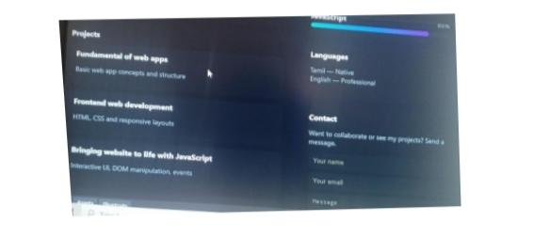
Result and screenshot

Slide 11
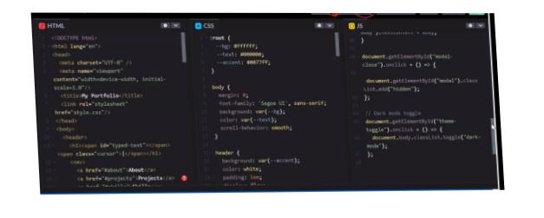

Slide 12
Features and functionality
Responsive Design – Works on mobile, tablet, and desktop. Interactive UI – Smooth navigation with menus & buttons. Project Showcase – Display projects with descriptions & links. Skills Highlight – Visual representation (charts / progress bars

Slide 13
Portfolio design and layout
Home Page – Brief introduction & welcome note About Me Section – Personal info, education, skills Projects Section – Showcase of completed works with details Skills Section – Technical & soft skills in list/graph format

Slide 14
Conclusion
A digital portfolio is more effective than a traditional resume. It showcases skills, projects, and achievements in an interactive way. Helps recruiters and clients quickly evaluate talent. Provides accessibility anytime, anywhere. Acts as both a professional profile and learning record. Enhances career opportunities and personal branding.

